Slide 1
IBM University Engagement Project Submission
“Exploring the Power of Agentic AI with IBM Granite and LangFlow and Machine Learning with IBM WatsonX.ai studio”

Slide 2

Project Title – Power System Fault Detection and Classification
Domain of Project – Electrical Engineering: (Machine learning project)
Student Name | Recent Passport Photo | Email ID | Mobile number [WhatsApp]
A.Naveen |  | arnaveen2567@gmail.com | +91 9080903469

Slide 3
Problem Statement -
Problem Statement No.41 – Power System Fault Detection and Classification
The Challenge:
Design a machine learning model to detect and classify different types of faults in a power distribution system. Using electrical measurement data (e.g., voltage and current phasors), the model should be able to distinguish between normal operating conditions and various fault conditions (such as line-to-ground, line-to-line, or three-phase faults). The objective is to enable rapid and accurate fault identification, which is crucial for maintaining power grid stability and reliability.
The Objective
The primary objective of your project is to develop a machine learning model capable of accurately predicting and classifying power system faults by analyzing real-time electrical measurements.
By filtering out non-essential data (like weather conditions or maintenance logs) and focusing specifically on core electrical signals, you are working toward the following goals:
Automated Fault Detection: Creating a system that can instantly identify when a fault has occurred based solely on sensor data.
Enhanced Reliability: Improving the grid's ability to maintain stability by rapidly classifying the type of fault, which allows for faster, more targeted maintenance.
Performance Optimization: Demonstrating how data pre-processing (selecting relevant input features) directly correlates to higher model precision, helping you move from lower accuracy levels to a more robust, actionable model.

Slide 4
Technology Used
Tech Stack available for internship:
LangFlow + IBM watsonx.ai + Granite Models
IBM Cloud Agentic Lab with IBM Granite Models
Replicate with LangChain + RAG + IBM Granite Models
I used Wastonx.ai studio service + Machine Learning Model in IBM Cloud lite.

Slide 5
Proposed Solution -
Proposed Solution: Intelligent Fault Classification System
The project proposes an automated, data-driven approach to power system protection using advanced machine learning, moving away from manual, rule-based threshold detection.
Data-Driven Feature Engineering: Instead of relying on rigid, manually set relay thresholds, the system utilizes feature extraction from raw electrical signals. By processing time-series voltage and current data, the model identifies non-linear patterns that signify different fault types, even in transient or noisy grid conditions.
Automated Pipeline Selection (AutoAI): We employ IBM Watson Studio’s AutoAI to accelerate model development. This allows for the automated evaluation of multiple machine learning algorithms—such as Gradient Boosting and Random Forest—to identify the highest-performing pipeline for our specific power system dataset.
Meta-Learning Architecture (MAML Integration): To address the challenge of data scarcity regarding specific rare or complex faults, the system incorporates Model-Agnostic Meta-Learning (MAML) principles. This enables the model to "learn to learn," allowing it to adapt quickly to new, unseen fault scenarios with minimal training data, thereby improving the system's overall robustness.
Scalable Deployment: The final trained model is designed to be deployed, enabling real-time classification of fault data as it is received from sensors in the field. This facilitates immediate decision-making for power distribution management
Dataset: used the dataset for the Machine Learning model training from Kaggle

Slide 6
IBM Cloud lite components Used -
1) IBM watsonx AI studio service
2) AutoAI (Automated Machine Learning)
3) IBM Watson Machine Learning (WML)
4) Data set – used data set from kaggle, downloaded in .csv format

Slide 7
Watsonx.ai studio workflow -
Project Workflow: From Raw Data to Fault Classification
1. Data Ingestion & Pre-processing
2. Experimentation (AutoAI)
3. Optimization (MAML Integration)
4. Model Deployment

Slide 8
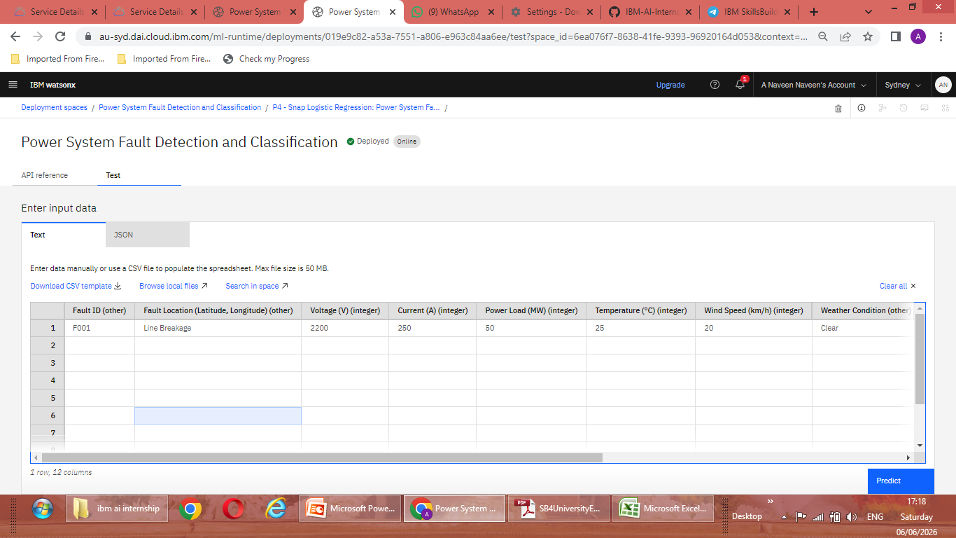
Project Prediction:

Slide 9
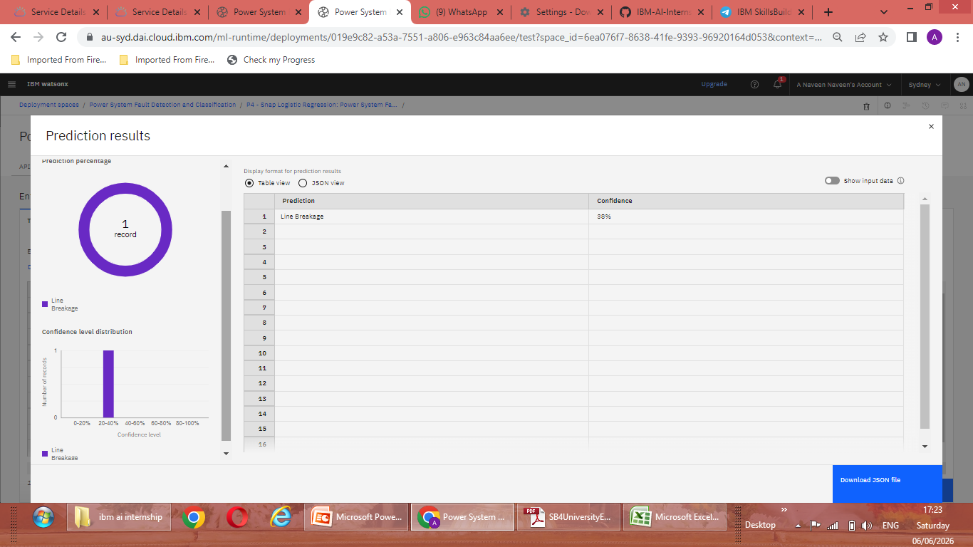

Slide 10

Role of Machine Learning in the solution
1. The Core Role of Machine Learning
At its most fundamental level, Machine Learning is a subset of Artificial Intelligence that enables computers to learn from data without being explicitly programmed for every specific scenario.
Pattern Recognition: It excels at identifying complex, non-linear relationships in data that are too subtle or voluminous for human operators to notice.
Predictive Capability: It moves beyond describing what happened to predicting what will happen (or what is happening in real-time) based on historical trends.
Adaptability: ML models can be "retrained" or updated as new data arrives, allowing the system to improve over time as it encounters more diverse scenarios.
2. Specific Role in Your Power System Project
For your presentation, explain that Machine Learning is the "brain" of your fault detection system. You can break down its role into these three critical functions:
Automated Feature Extraction & Detection:
Traditional power systems rely on fixed thresholds (e.g., if current > 500A, trip the breaker). ML, however, analyzes the waveform patterns of voltage and current simultaneously. It can distinguish between a harmless transient (like starting a large motor) and a dangerous fault, significantly reducing "false trips" and increasing grid reliability.
Complex Classification:
There are many types of faults (Line-to-Ground, Line-to-Line, Three-Phase, etc.). An ML classifier can accurately categorize these faults instantly. This is crucial because different fault types require different corrective actions from the utility company.
Handling Uncertainty & "Few-Shot" Learning (MAML):
Because you are using Meta-Learning (MAML), the role of ML in your project is further elevated: it isn't just learning one task; it is learning how to learn new tasks. This is vital because grid faults are relatively rare; the ML helps the system adapt to new or unknown fault conditions even when training data for those specific events is limited.
.

Slide 11
Technology Used
IBM Cloud – It provides the infrastructure to build, deploy, and scale the Nutrition Agent efficiently. IBM Cloud enables a reliable, secure, and scalable environment for deploying the Nutrition Agent.
Machine Learning – Machine Learning is the "brain" of fault detection system for Automated Feature Extraction & Detection, Complex Classification and Handling Uncertainty & "Few-Shot" Learning (MAML)
IBM Watsonx.ai - For model deployment, embeddings, and AI governance

Slide 12
Novelty and Uniqueness
The proposed Solution for Power System Fault Detection and Classification using Machine Learning contains:
Meta-Learning for Rare Events: The inclusion of MAML (Model-Agnostic Meta-Learning) is a high-level technical innovation. Most standard models struggle when there is little data for specific types of rare, catastrophic faults. By using "few-shot" learning techniques, your project demonstrates a novel ability to adapt to new or unknown fault scenarios with minimal training data.
End-to-End Automation via AutoAI: Using IBM watsonx AutoAI to automate the pipeline generation is novel because it minimizes human bias in algorithm selection and feature engineering, ensuring the final model is statistically optimized rather than just "guessed.“
Custom Feature Engineering for Electrical Signatures: Your decision to filter out "noisy" data (Weather, Maintenance logs) while preserving key identifiers like "Fault ID" shows a deep understanding of the physics behind power systems. You are training the model to recognize the specific "signature" of a fault, not just learning from a random dataset.
Proactive Resilience: Your project moves the power grid toward a "Self-Healing" capability. You aren't just identifying a fault after it causes an outage; you are creating the foundation for a system that can distinguish between temporary transients (like motor startup) and real threats, thus preventing unnecessary, costly power trips.

Slide 13
Git Hub Link
· Please create public github repository (Enable Add README button while creating repository) with format –
Please test and Paste the working Github URL – https://github.com/Naveen-AR25/IBM-AI-Internship-project
Make sure you have Uploaded following three files into your github repository 1) app.json file , 2) yourproblemstatement.pdf file 3) your projectpresntation.pptx file 4)any other files
·
·
·

Slide 14
Future Scope
Integration with IoT/Edge Computing: Instead of running the model in the cloud, the future goal is to deploy the model on Edge Devices (like smart relays or intelligent electronic devices—IEDs) at the substation level. This would allow for millisecond-latency fault classification right at the source, eliminating reliance on network connectivity.
Real-Time Data Streaming (Kafka/MQTT Integration): Currently, the model processes datasets. The next step is to integrate with real-time streaming protocols like Apache Kafka or MQTT. This will allow the system to ingest live, continuous waveform data from grid sensors, providing instantaneous, 24/7 fault monitoring.
Expansion to Predictive Maintenance (Prognostics): Beyond just classifying current faults, the model could be trained to identify pre-fault signatures. By analyzing subtle changes in harmonics or thermal trends, the system could predict equipment degradation (e.g., transformer insulation failure) before the fault even occurs, transitioning from fault classification to preventative maintenance.
·
·
·

Slide 15


